Slide 1


Slide 2
What do we mean by Demography?
Demography is the statistical data on the human race, such as:
sex,
age,
ethnicity
religion
and income.

Slide 3
Data methods
Two methods of data collection: direct and indirect.
Direct data come from statistics registries including all births and deaths as well as changes in legal status such as marriage, divorce, and migration.
https://www.ons.gov.uk/census

Slide 4
Indirect methods of collecting data are required in countries where full data are not available, such as the developing world.
One of these techniques is the sister method, where survey researchers ask women how many of their sisters have died or had children and at what age.
Other indirect methods include asking people about siblings, parents, and children.

Slide 5
Changes in UK population levels
Factors for Growth
Birth rate
Death rate
Migrations

Slide 6
The birth rate
Birth rate in England and Wales has decreased as official figures show.
They reveal that one in five pregnancies nationwide ends in an abortion.
Women are waiting on average until the age of 27 before starting a family.

Slide 7
The death rate
The death rate has been relatively stable and has played a relatively small part in changing the total population level.
The main feature of mortality in the UK has been a small decline in age specific death rates so you have more old people.
Also the death rate of women has fallen more than for men.

Slide 8
BIRTH RATE trends
- smaller families as people become better off and health improves and death rates fall;
- the increased availability of contraception;
- later marriages and later childbearing for social and/or economic reasons;
- declining fertility rates;
- changing attitudes towards women and work.
DEATH RATE trends
- rising living standards, including better housing, sanitation and nutrition;
- developments in medical technology and practice;
- better education;
- improved working conditions.
01
the consequence is an ageing of the population

Slide 9
Migration
Migration is the movement of people from one place to another.
It can be international (movement between different countries) or internal (movement within a country, often from rural to urban areas).
Today, with modern transportation and communications, more people are motivated and able to move.

Slide 10
Why do people migrate?
People migrate for many reasons. These can be:
Economic: This involves moving to find work or follow a particular career path.
Social: This involves moving some where for a better quality of life or to be closer to family or friends.
Political: This involves moving to escape political, religious or ethnic persecution, or conflict.
Environmental: Causes of this type of migration include natural disasters such as flooding or drought.

Slide 11
Some facts of today’s British society
One in three of us live on our own and the number of divorced people has almost doubled.
People now produce fewer children but own more pets and 50% will be over retirement age.
An increasing number of people live in the country, far from inner cities.

Slide 12
Personal and protective services are very popular jobs. Nannies, domestic help, hairdressers, nurses and catering staff will all become increasingly popular careers.
The next largest group is managers and administrators, which has grown by almost 10%.
Professionals and sales assistants have increased in numbers.
The number of clerical and secretarial workers has diminished- victims of the technological revolution.

Slide 13
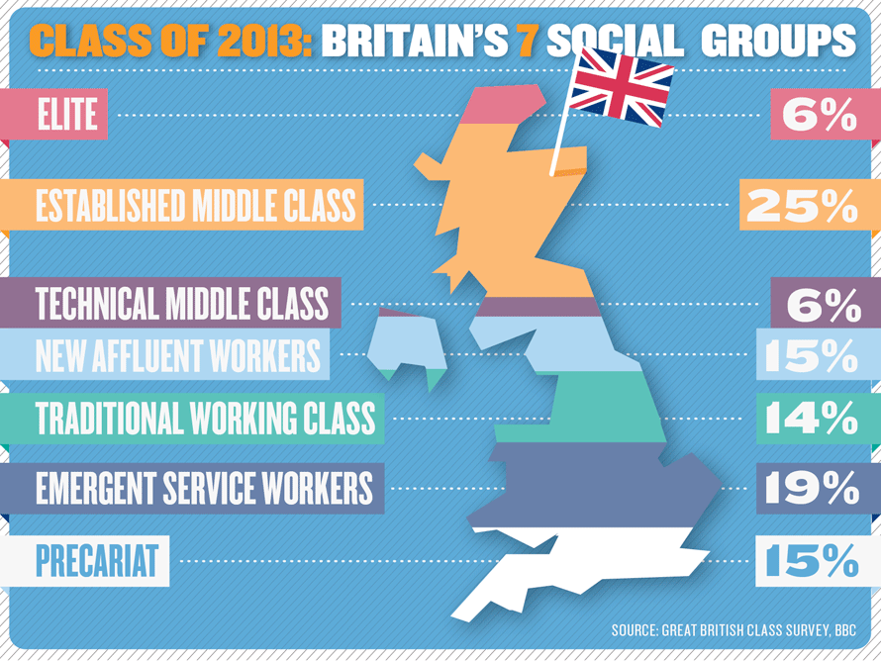
01

Slide 14
Changes in the family composition
Family has changed dramatically.
The proportion of divorced people will almost double in the three decades to 2020.
For those who do get married, the proportion will fall to 49% in 2020.
In 2016 there was almost 24 million households in England, and more than one in three consisted of people living on their own.

Slide 15
The findings predict that the population will grow to 61.2 million by 2023. From then on, deaths will exceed births.
Women's decision to have fewer children, at an older age, will result in 15% fewer children, while 50% more of us will be over the retirement age.
Recent research has shown that the cost of bringing up a child from birth to university is £164,000.
The less well-off have, on average, 2.7 children compared with 2 for middle- class parents and 2.3 for the top social class.

Slide 16
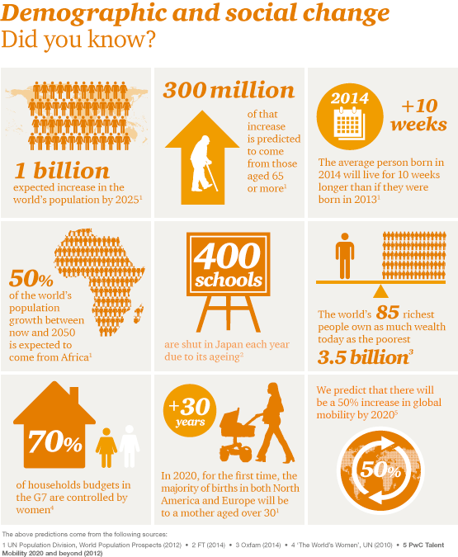
01

Slide 17
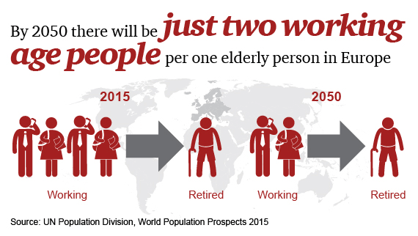

Slide 18
Population composition
Population composition is the description of population defined by characteristics such as age, race, sex or marital status.
This data is often compared using a population pyramid.
It consists of two bar graphs, with the population plotted on the X-axis and age on the Y-axis.
One showing the number of males and one showing females in a particular population in five-year age groups.

Slide 19
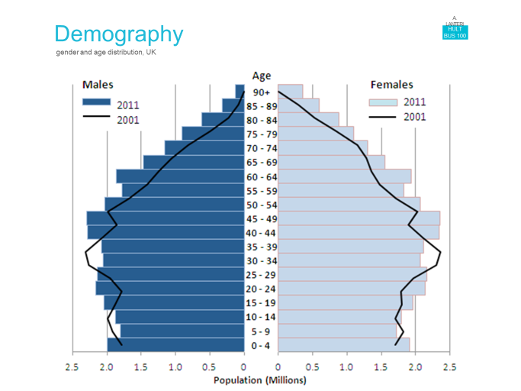

Slide 20
Importance of Demographics for Businesses
A number of reasons can be identified why business organisations should study demographic trends. Two examples are:
On the demand side, demography helps to depict the size of the market that a product is likely to face, e.g. the increase in the number of elderly people
Demographic trends have supply side effects. Labour is a key resource and a study of demographics will indicate the human resources that an organisation can expect to have available to it in future years.

Slide 21
Demand side implications
Companies can use demographic data to identify characteristics in the population to find:
who their potential customer actually is, and
to locate the geographic area where the most potential customers live.
This information is then used in their marketing to identify which products to carry, how to use their advertising money, and what the buying habits of these people are.

Slide 22
So for example, you wanted to market a new line of denture cleaners, you would want to know:
where the majority of elderly consumers live,
how many wear dentures, and
whether they were on fixed income.
Getting the answers to these types of questions is what demographic data studies will do for you.

Slide 23
The first question to ask when using target marketing is:
Is a product to be sold to a household or an individual?
Households can be broken down as "family" households and "nonfamily" households.
The younger the person, the more likely they are to live in a nonfamily household (such as with a roommate or significant other).

Slide 24
Once that question has been answered, a company can use demographics to compile a "customer profile" of their target audience.
Factors that should be considered in the profile include:
Ethnic background: It is important to make a distinction between ethnicity and race.
The term "Hispanic“ for example, refers to an ethnic group, not a race of people.

Slide 25
Income: Income tends to increase with age as people get better-paying jobs and receive promotions. Married couples often have a higher income because both spouses are working.
Education level: This is an increasingly important factor as technology becomes more important to day-to-day living.
The more education a person has, the greater the income they earn, thus the more money they have to purchase products.
Other important demographic factors include age, sex, geographic location, occupation, size of family, and ages of the children in the family unit.

Slide 26
Supply side implications
Companies try to match the opportunities they face with the resource strengths they possess.
Labour is a key resource, thus a study of demographics will show what type of people they can expect to use in order to achieve their goals.
For example, a business that has relied on relatively low wage young employees, would need to take it into consideration the availability of this type of worker when developing its product strategy.

Slide 27
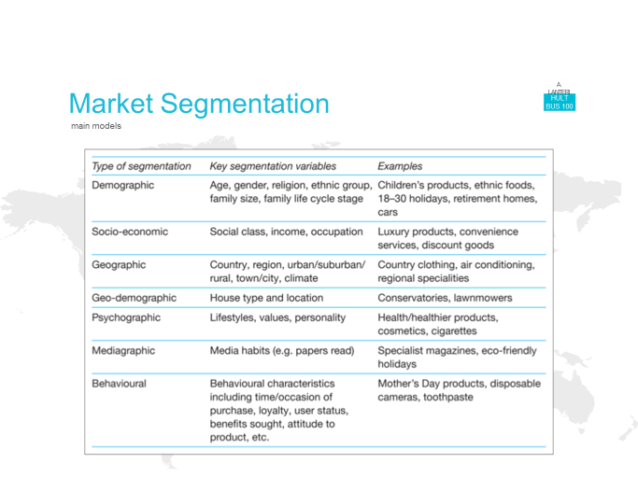

Slide 28
Home work Task
Prepare a short report on your home country:
Analyse each of the main social factors
Describe the population, social classes, spending habits, and culture.
Prepare a short presentation (3 to 4 slides).

